Slide 1

CropDoc Solutions
AI-Powered Plant Disease Detection & Farmer Support Chatbot
CropDoc AI Data Team

Slide 2


Company Introduction
Who We Are
Mission: To democratize access to agricultural expertise for rural farmers using accessible Artificial Intelligence.
Vision: A world where every farmer, regardless of location or literacy, has a plant pathologist in their pocket.
Core Focus: Developing lightweight, explainable, and farmer-friendly AI tools to secure global food supply chains.

Slide 3
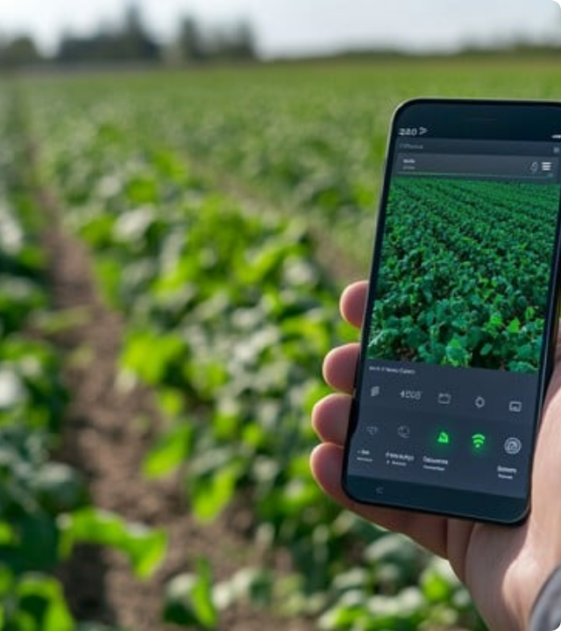
The Product: CropDoc
The Problem
Diseases cause 20–40% of global yield losses. Rural farmers lack access to experts, and existing AI apps are untrustworthy "black boxes".
The Solution
1. Visual Diagnosis: ResNet-9 (lightweight CNN) for instant detection.
2. Explainability: Grad-CAM heatmaps to build trust.
3. Advisor Chatbot: LLM-powered non-chemical advice.

Slide 4
SMART Goals
Specific: Develop a web-based prototype combining ResNet-9, Grad-CAM, and RAG-based chatbot.
Measurable: Achieve 94–97% accuracy and ensure efficient runtime on low-resource devices.
Achievable: Utilize open-source PlantVillage datasets and transfer learning within 8 months.
Relevant: Address lack of extension services, supporting UN SDG Zero Hunger.
Time-bound: Complete all phases from data collection to defense by Month 8.

Slide 5


Stakeholders & Expectations
Farmers
Investors
Expect accurate, instant diagnoses and simple, actionable advice without complex jargon.
Expect a scalable product with low deployment costs (low server/GPU overhead).
Extension Officers
Research
Expect a tool that helps them screen more farms quickly and efficiently.
Expect rigorous validation of the "Explainable AI" (Grad-CAM) component.

Slide 6






Risk Assessment
Technical
Business
Ethical
Real-world photos may drop accuracy. Mitigation: Data augmentation. Chatbot hallucination. Mitigation: Curated Knowledge Base.
Low digital literacy and connectivity. Mitigation: Offline-first, lightweight model design for rural accessibility.
Bias in data and safety of advice. Mitigation: Diverse datasets and strictly non-chemical advice to avoid liability.

Slide 7


The Data Team
Hamza Shahid (Lead): Project management, Model architecture (ResNet-9), training pipeline.
Hottam ud din (ML Engineer): Data preprocessing, API development (Flask), Cloud deployment.
Tariq Jamil (NLP/Frontend): Chatbot development, UI/UX design for farmers.
Combined Skills: Python, TensorFlow/PyTorch, Computer Vision, NLP, Web Development.

Slide 8


Conflict Management Strategies
Prevention
Resolution
•
1. Early Identification: Issues raised in weekly meetings.
•
4. Objective-Based: Decisions align with project goals.
•
2. Open Discussion: Focus on facts, not emotions.
•
5. Voting: Majority vote for technical disputes.
•
3. Role-Based Adjustment: Redistribute tasks if needed.
•
6. Mediation: Supervisor acts as final judge.
•
7. Documentation: All decisions logged to prevent recurring issues.

Slide 9
Project Timeline (8 Months)
Months 1-2
Months 3-4
Months 5-6
Months 7-8
Literature Review & Data Collection
Training ResNet-9 Model
Grad-CAM & Chatbot Dev
Deployment & Final Defense

Slide 10

Resources Required
Hardware & Software
Compute: GPUs (Google Colab / Tesla T4), 8GB+ RAM.
Stack: Python, PyTorch, OpenCV, Flask, Hugging Face.
Data: "New Plant Diseases Dataset" (Kaggle).

Slide 11




Control Measures
Measures of Success
Measures of Deviation
•
Accuracy: F1-Score > 0.95
•
Weekly Code Reviews: Prevent technical debt.
•
Latency: Inference < 2s
•
Loss Monitoring: Detect overfitting early.
•
Trust: Positive user feedback
•
Scope Adjustment: Drop non-critical features if >1 week delay.

Slide 12
Questions?
Thank you for listening!
CropDoc Solutions | team@cropdoc.ai

Slide 13



Image Sources
https://images.stockcake.com/public/8/0/0/8003ae59-da5a-4a5e-9a5a-c5bd68ada835_large/smartphone-agriculture-monitoring-stockcake.jpg
Source: stockcake.com
https://png.pngtree.com/thumb_back/fw800/background/20251125/pngtree-diverse-team-of-professionals-collaborating-in-a-modern-office-meeting-room-image_20588350.webp
Source: pngtree.com
https://newscenter.lbl.gov/wp-content/uploads/2025/12/Featured_1190px_DataCenters_iStock-1809660148.jpg
Source: newscenter.lbl.gov

